Slide 1
STAT 441 Project
STAT 441 Project
Group 23/Team Struggle
Adyant Tian Jason

Slide 2
Table of Contents
Preprocessing
Modeling
Conclusion
Stacking
01
02
Missing values
One-hot encoding
Normalization
Null Values
XGBoosting
Neural network
Failed attempts
04
03

Slide 3
Preprocessing
01

Slide 4
Data Processing
ID Data Type
Standardize Numeric Data
One-Hot Encoding
Null Values
Categorized numeric variables based on range to determine data type
Numeric data was standardized to be in the range of [-1,1]
(x-μ)/𝝈^2
Non-ordinal categorical data converted to binary values
10 observation among 4 variables with null values. Replaced with variables’ rounded mean

Slide 5
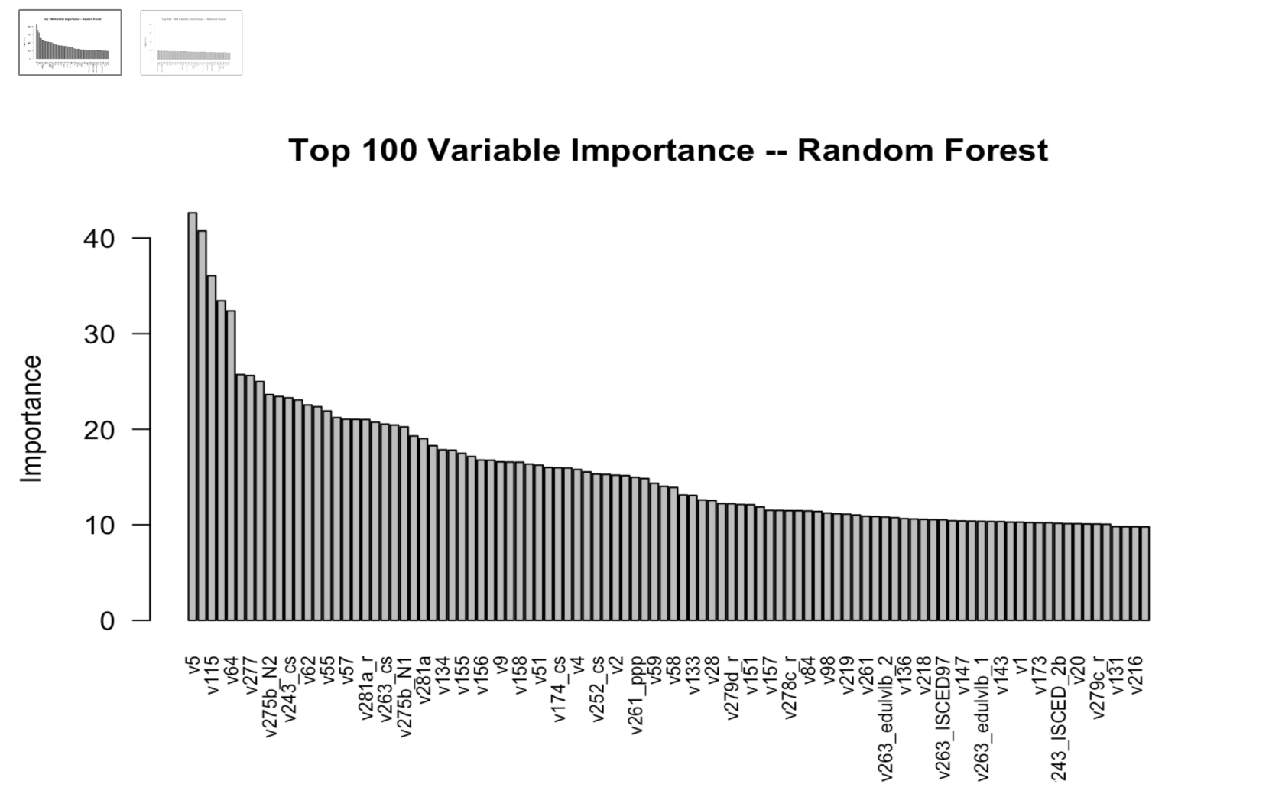
Important Variables
Feature Selection
v63, v5, v54, v64, v115, v56, v57, v282, v93, v52_cs, v277, v261_ppp
V63 - how important is God in your life
V5 - how important in your life: politics
V54 - how often attend religious services
V64 - how often do you pray outside religious services
V115 - how much confidence in: church
Notes:
Jason

Slide 6
Modelling
02
Notes:
Jason

Slide 7
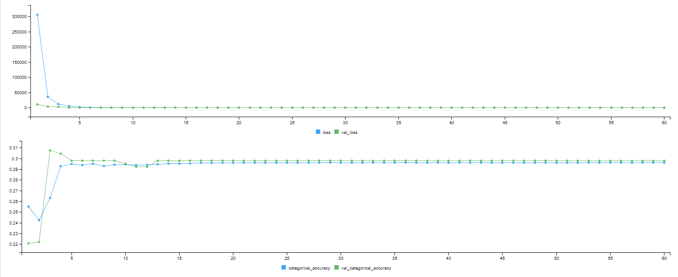
Neural Network - Attempt 1
Failed: Using the data without standardizing it. Due to data are measured in different scales. The results are not ideal, Caped at 0.3 Accuracy in both fit and predication
Notes:
Jason

Slide 8
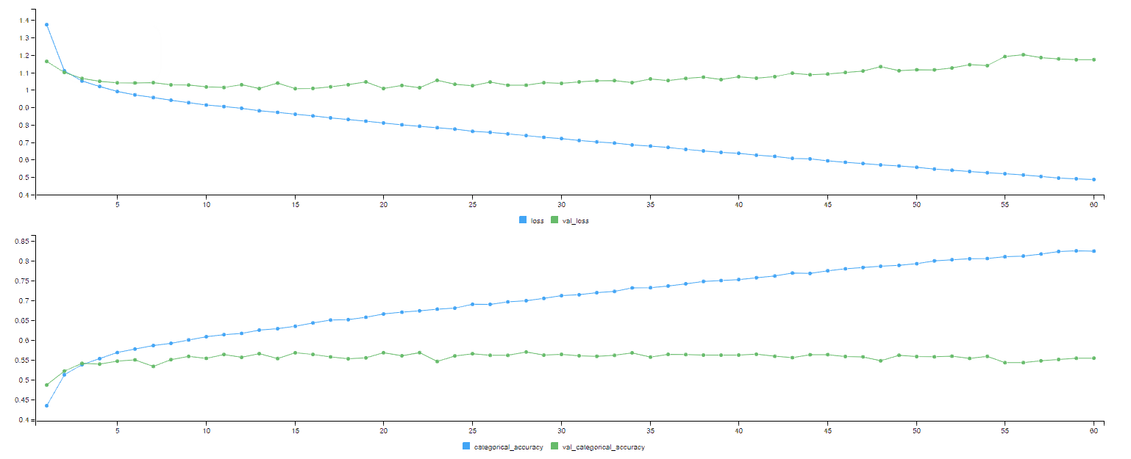
Neural Network - Attempt 2
Failed: Adding more layers does not improve the prediction power, but able the Neural Network to fit to the dataset very well. I.e. Overfit. However, by standardizing data, we are able to get better results
Notes:
Jason

Slide 9
Neural Network - final
Final Neural Network:
Two hidden layer,
200 neurals, with L2 penalty
Relu as activation function
Dropout Layer for Regularization technique to prevent overfitting
Batch normalization layer to maintain mean close to 0 and standard deviation close to 1.
Softmax as activation function for output layer
Notes:
Jason

Slide 10
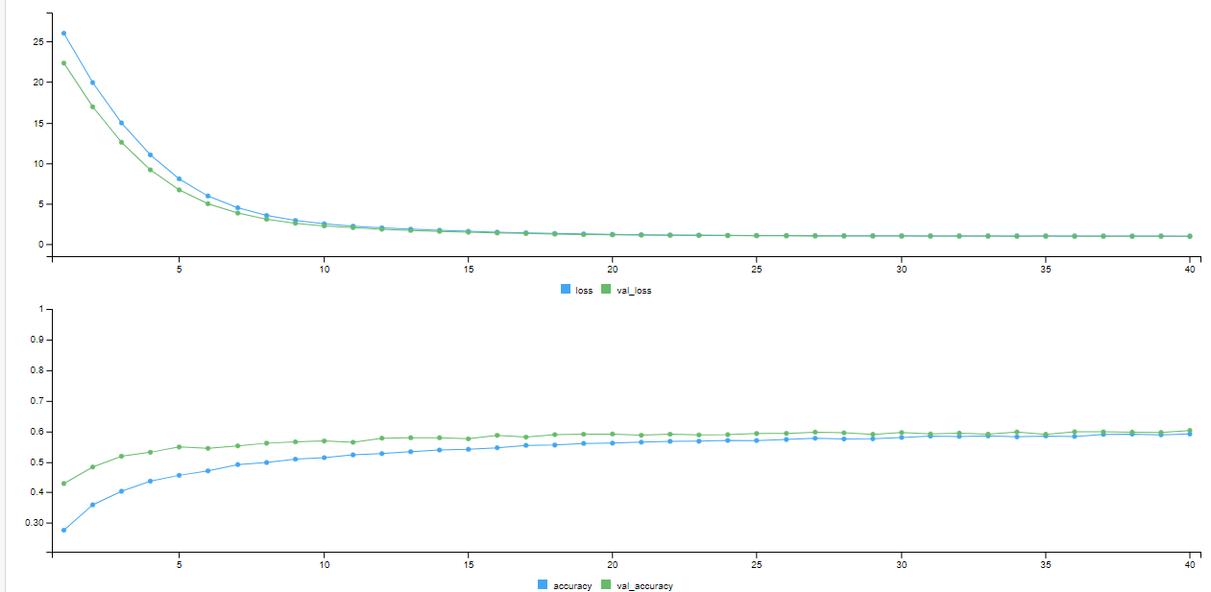
Neural Network - final Graph
Notes:
Jason

Slide 11
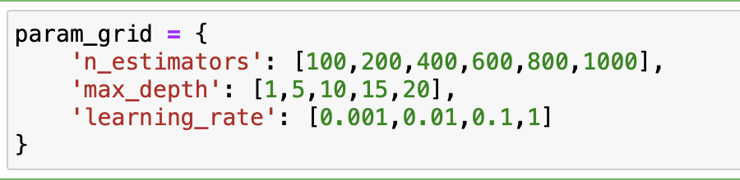
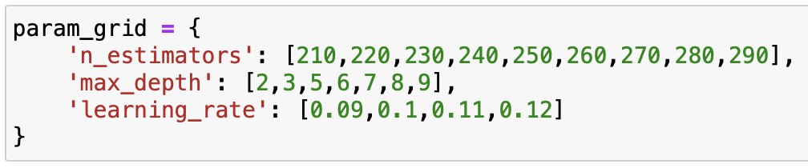
XGBoost
Reasons for choosing:
Higher performance
Reducing overfitting
Parameter Fine Tuning
Grid Search
Cross Validation
Final XGBoost Model:
Max depth = 5
Learning rate = 0.1
Iterations/N_Estimators= 250
Attempted Feature Selection (Failed Attempt)
Public Kaggle Score: 0.86852
Initial grid search
...
Final grid search

Slide 12
Failure Attempts
Septerare repown into -1 and rest, then run classiciftion again on non-negtive 1 value
Feature selection

Slide 13
Stacking
03

Slide 14
Stacking - attempt 1
Base Classifiers:
Fine-tuned XGboosting (CV score: 0.643)
Fine-tuned Random Forest (CV score: 0.603)
Fine-tuned Neural Network (CV score: 0.612)
Final Classifier:
Fine-tuned XGboosting

Slide 15
Stacking - attempt 1
Results: performed worse than XGboosting (XGboost public Kaggle score: 0.86852)
Cross validation score: 0.641
Kaggle score: 0.928 (public), 0. 916 (private)
Concerns: Overfitting
Tried using simpler classifier to prevent overfitting, which leads to our second attempt

Slide 16
Stacking - attempt 2
Base Classifiers:
Fine-tuned XGboosting
Fine-tuned Neural Network
Fine-tuned Random Forest
Final Classifier:
logistic
Cross validation score: 0.602

Slide 17
Stacking - Insights
Aiming to fully leverage the advantages of stacking, we tried a few different stacking approaches.
None of them performed better than the XGBoosting model
Stacking doesn’t provide any significant advantage for this particular dataset

Slide 18
Conclusion
04

Slide 19
Conclusion
For large dataset like this (400+ predictors and 48,000 observations)
the model need to be computational efficient
preprocessing is the key (standardization, one-hot encoding, etc.)
XGBoosting gives the best score

Slide 20

Did you know?
This project is known as laptop killer, effectively turn three laptop into three toaster with computing power
This image is generated by DALL.E

Slide 21
Thank you

